Slide 1
Fundamental of Risk and Return
Defining risk and return;
Expected rates of return;
Historical rates of return;
Standard deviation;
Coefficient of variation;
Risk aversion and required returns;
Return and risk in a portfolio context: The role of covariance and correlation;
The capital asset pricing model (CAPM): the beta coefficient;
The security market line (SML)
The relationship between risk and rates of return

Slide 2
Defining Risk and Return
The level of expected risk increases, the level of expected return also increases.
Concept of Return
Return is the difference between terminal wealth (T.W.) (what an investor received) and initial wealth (I.W.) (what an investor invests)
T.W. > I.W. = positive return from investment
T.W. < I.W. = negative return from investment
T.W. = I.W. = zero return from investment
Measurement of return for a Single Assets
Rupee Return
Measured in absolute as well as in relative term
Absolute return = capital gain or loss + cash receipt
Capital gain = sale price – purchase price
Cash receipt = dividend or interest received
Rupee return = (P₁-P₀ ) + C₁
Problem: to know scale (size) of investment and timing of return

Slide 3
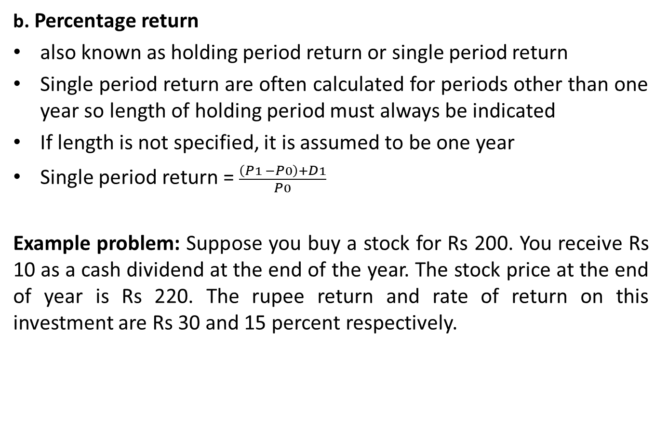
Measurement of return for a Single Assets
b. Percentage return
also known as holding period return or single period return
Single period return are often calculated for periods other than one year so length of holding period must always be indicated
If length is not specified, it is assumed to be one year
Single period return = $\frac{\left(P1 −P0\right)+D1}{P0}$
Example problem: Suppose you buy a stock for Rs 200. You receive Rs 10 as a cash dividend at the end of the year. The stock price at the end of year is Rs 220. The rupee return and rate of return on this investment are Rs 30 and 15 percent respectively.

Slide 4
Probability Distribution
Probabilities are numbers that indicate the likelihood that an uncertain event will occur. Some rules of probabilities are:
A probability can never be a negative number
A probability can never be larger than 1 (or 100%)
The probabilities attached to all the different possible outcomes must sum to exactly 1 (or 100%)
An outcome that is certain to occur has a probability of 1; no other outcome is possible
Impossible outcomes are assigned to probability of 0.
Probability distribution assigns a probability to every possible outcome of an uncertain situation
The wideness of a probability distribution of rate of return is a measure of uncertainty or risk
The risk or wideness of probability distribution is called variance.

Slide 5
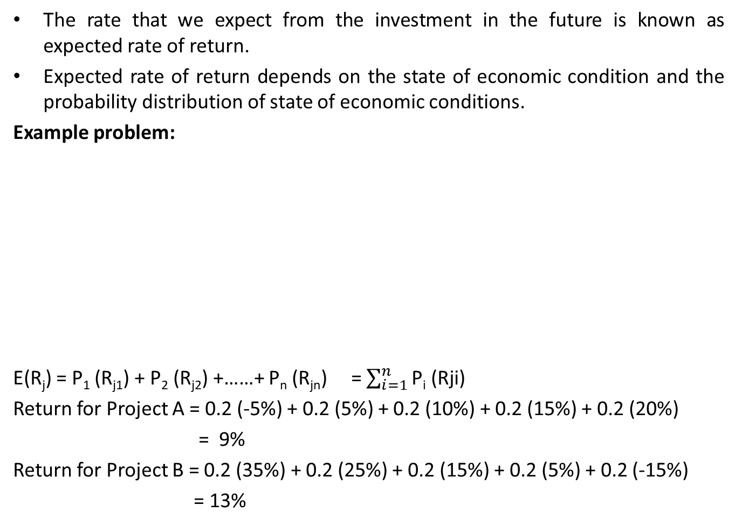
Expected Rate of Return
The rate that we expect from the investment in the future is known as expected rate of return.
Expected rate of return depends on the state of economic condition and the probability distribution of state of economic conditions.
Example problem:
E(R_{j}) = P₁ (R_{j1}) + P₂ (R_{j2}) +……+ P_{n} (R_{jn}) = $\sum_{i=1}^{n}{\text{P}\text{i}\text{ (}\text{Rji}\text{)}}$
Return for Project A = 0.2 (-5%) + 0.2 (5%) + 0.2 (10%) + 0.2 (15%) + 0.2 (20%)
= 9%
Return for Project B = 0.2 (35%) + 0.2 (25%) + 0.2 (15%) + 0.2 (5%) + 0.2 (-15%)
= 13%
Economic condition | Probability | Project A | Project B
Very Bad | 0.2 | -5% | 35%
Bad | 0.2 | 5% | 25%
Average | 0.2 | 10% | 15%
Good | 0.2 | 15% | 5%
Very Good | 0.2 | 20% | -15%

Slide 6
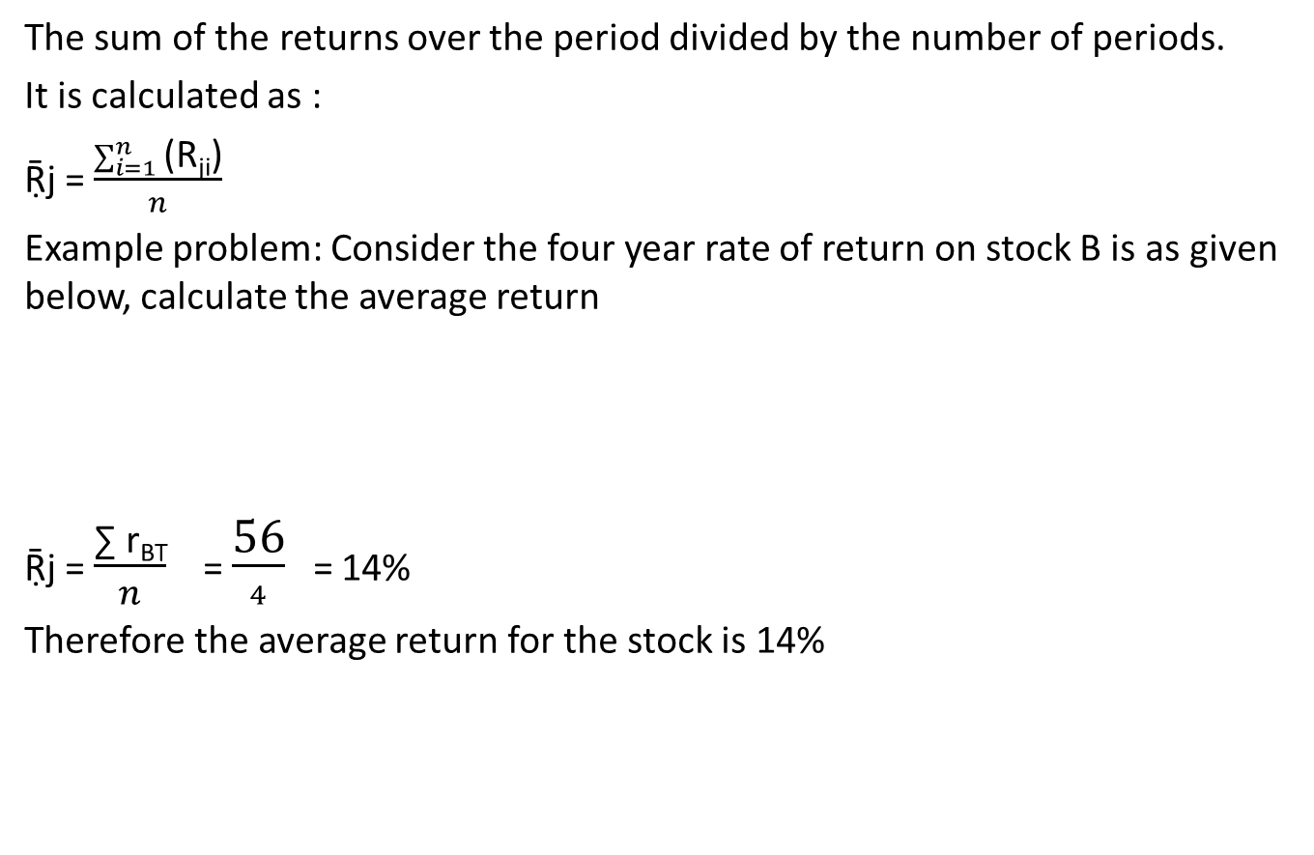
Average Rate of Return of Arithmetic Mean
The sum of the returns over the period divided by the number of periods.
It is calculated as :
Ṝj = $\frac{\sum_{i=1}^{n}{\text{(}\text{Rji}\text{)}}}{n}$
Example problem: Consider the four year rate of return on stock B is as given below, calculate the average return
Ṝj = $\frac{\text{∑ }\text{rBT}}{n}$ = $\frac{\text{56}}{4}$ = 14%
Therefore the average return for the stock is 14%
Year | 1 | 2 | 3 | 4 | Solution: n = 4
Rate of return (%) | 10 | 12 | 16 | 18 | ∑ r_{BT} = 56

Slide 7
Required Rate of Return
The rate of return a firm must earn to compensate its stockholders for their risk exposure.
Investor must consider the real rate of return, expected inflation and risk
Required rate of return for an asset can be estimated using the equation for the security market line suggested by capital assets pricing model
Required rate of return = Risk free rate + Risk Premium
Risk free rate = real rate of interest + inflation premium
Investment is made if expected rate if interest is greater or at least equal to the required rate of return.

Slide 8
Concept and Measurement of Risk
Whenever we are in situation where the outcome is unknown, we are exposed to risk.
Risk is defined as the variability of the returns from the investment during a certain period.
The more certain the return from an assets, the less variability and therefore the less risk.
Among two project A and B of previous slide , Project B is more riskier than project A as rate or return on project B varies in a wider range than that of Project A.

Slide 9
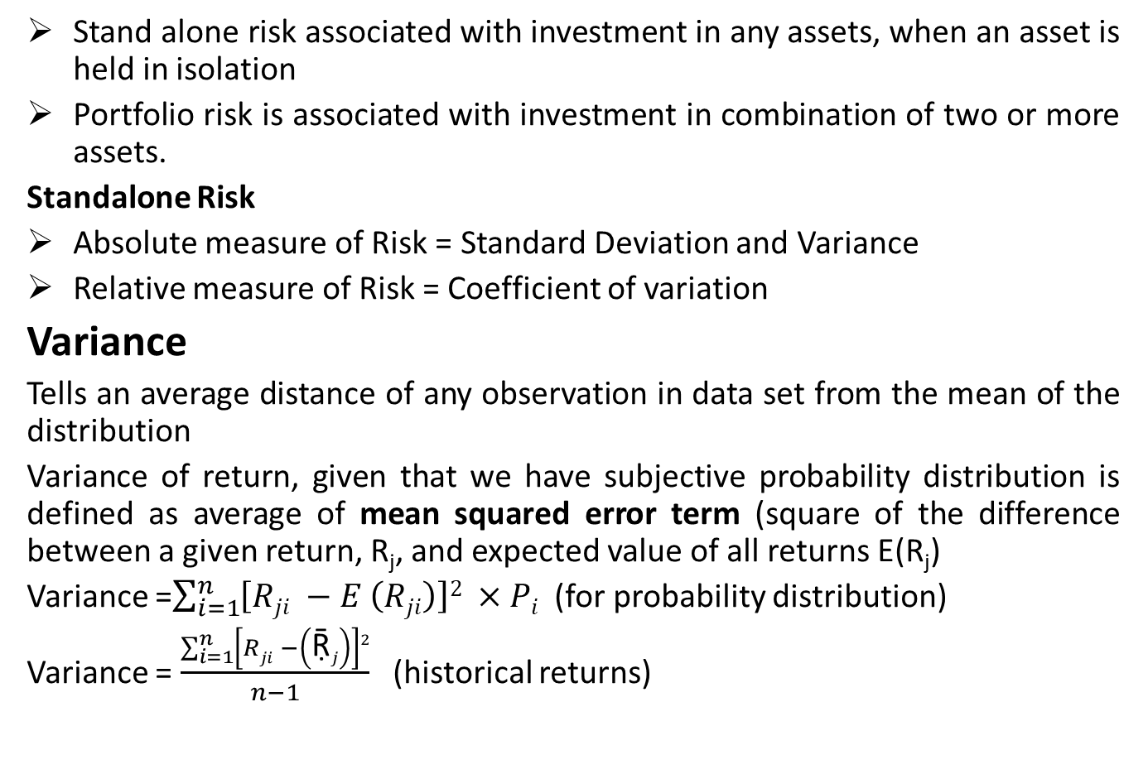
Measurement of Risk
Stand alone risk associated with investment in any assets, when an asset is held in isolation
Portfolio risk is associated with investment in combination of two or more assets.
Standalone Risk
Absolute measure of Risk = Standard Deviation and Variance
Relative measure of Risk = Coefficient of variation
Variance
Tells an average distance of any observation in data set from the mean of the distribution
Variance of return, given that we have subjective probability distribution is defined as average of mean squared error term (square of the difference between a given return, R_{j}, and expected value of all returns E(R_{j})
Variance =$\sum_{i=1}^{n}{\left[Rji −E \left(Rji\right)\right]2 ×Pi}$ (for probability distribution)
Variance = $\frac{\sum_{i=1}^{n}{\left[Rji −\left(\text{Ṝ}j\right)\right]2}}{n−1}$ (historical returns)

Slide 10
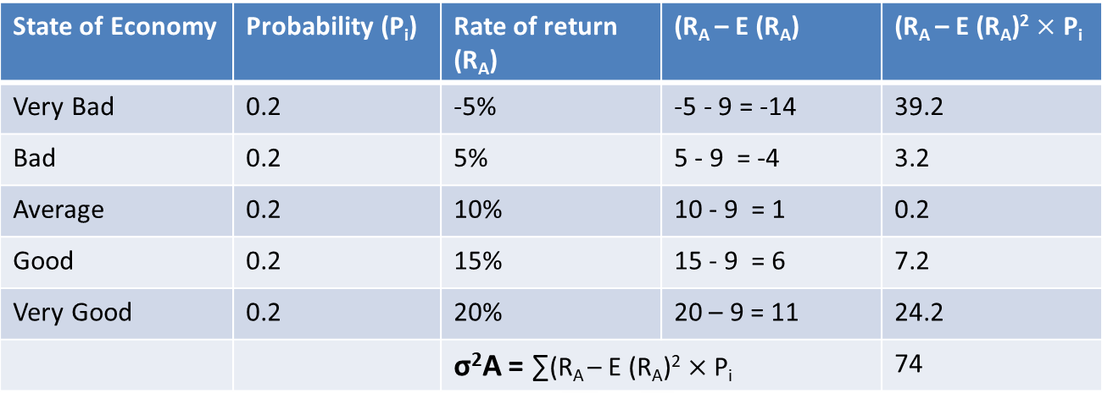
Example for calculation of variance
Variance for return of project A
Calculate the variance for return of Project B and identify which project is risky and why?
State of Economy | Probability (P_{i}) | Rate of return (R_{A}) | (R_{A} – E (R_{A}) | (R_{A} – E (R_{A})² $×\text{P}\text{i}$
Very Bad | 0.2 | -5% | -5 - 9 = -14 | 39.2
Bad | 0.2 | 5% | 5 - 9 = -4 | 3.2
Average | 0.2 | 10% | 10 - 9 = 1 | 0.2
Good | 0.2 | 15% | 15 - 9 = 6 | 7.2
Very Good | 0.2 | 20% | 20 – 9 = 11 | 24.2
 |  | σ²A = ∑(R_{A} – E (R_{A})² $×\text{P}\text{i}$ |  | 74

Slide 11
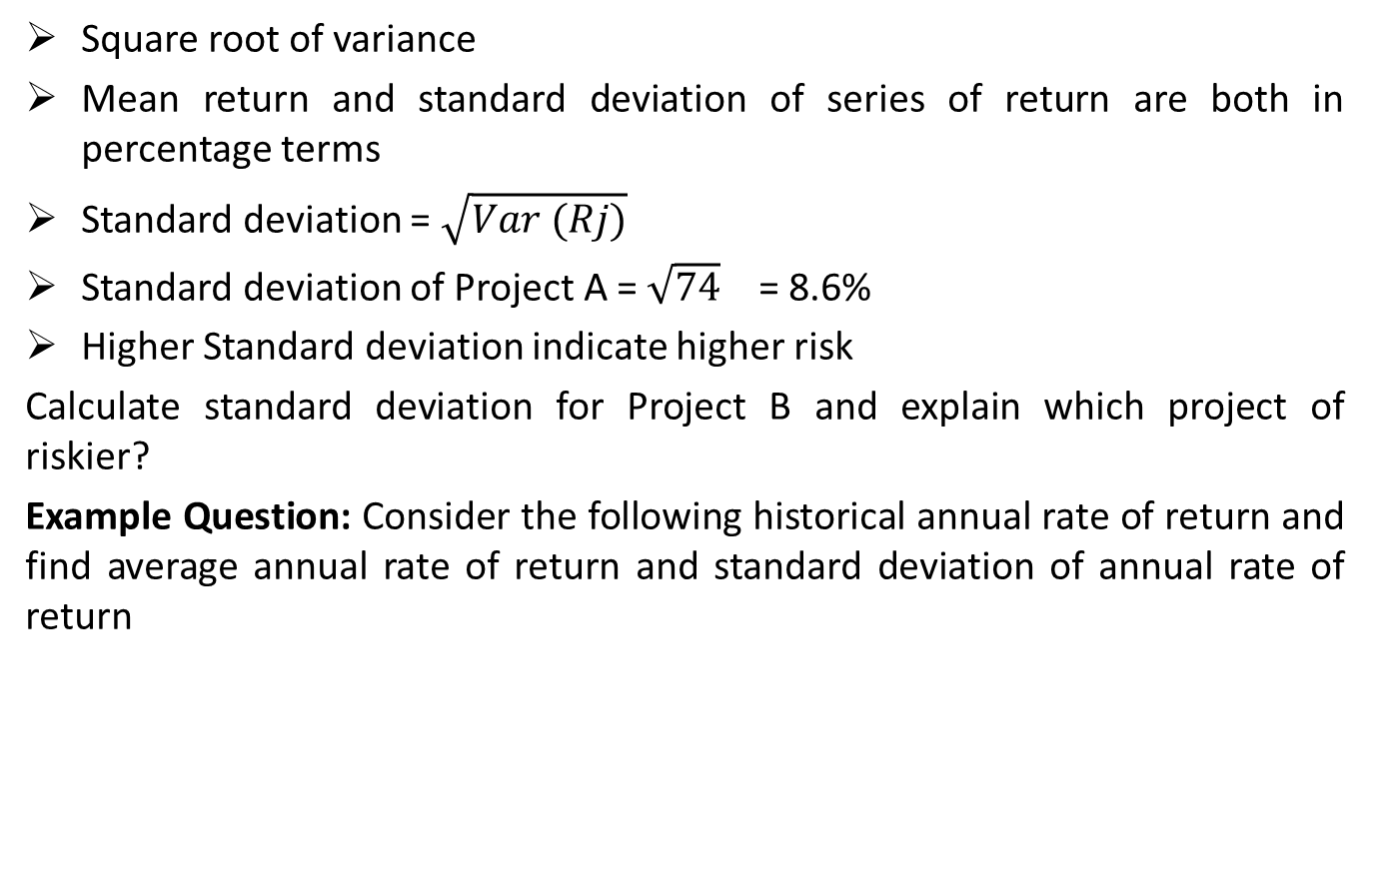
Standard Deviation
Square root of variance
Mean return and standard deviation of series of return are both in percentage terms
Standard deviation = $\sqrt{Var (Rj)}$
Standard deviation of Project A = $\sqrt{74}$ = 8.6%
Higher Standard deviation indicate higher risk
Calculate standard deviation for Project B and explain which project of riskier?
Example Question: Consider the following historical annual rate of return and find average annual rate of return and standard deviation of annual rate of return
Year | Rate of Return
2012 | 30%
2013 | -10%
2014 | 40%

Slide 12
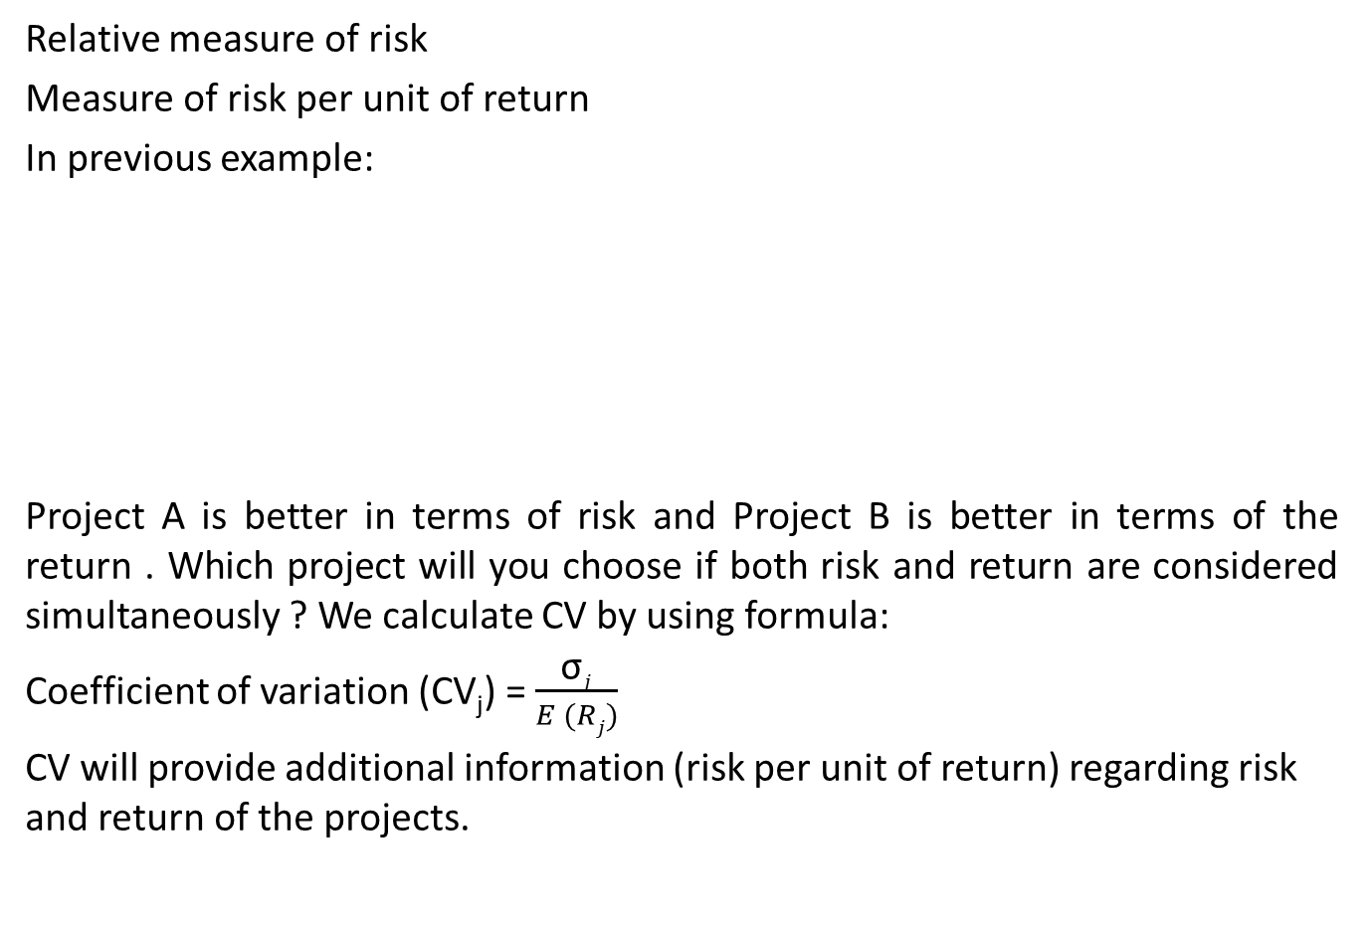
Coefficient of Variation (CV)
Relative measure of risk
Measure of risk per unit of return
In previous example:
Project A is better in terms of risk and Project B is better in terms of the return . Which project will you choose if both risk and return are considered simultaneously ? We calculate CV by using formula:
Coefficient of variation (CV_{j}) = $\frac{\text{σ}j}{E (Rj)}$
CV will provide additional information (risk per unit of return) regarding risk and return of the projects.
 | Project A | Project B
Expected Return | 9% | 13%
Variance | 74 | 296
Standard Deviation | 8.6% | 17.2%

Slide 13
Practice Question
1. Consider the following two investments A and B.
Calculation of average returns, standard deviations and coefficient of variation of returns for investments A and B
 | Rate of return
Year | Investment A | Investment B
2004 | 15.6% | 8.4%
2005 | 12.7% | 12.9%
2006 | 15.3% | 19.6%
2007 | 16.2% | 17.5%
2008 | 16.5% | 10.3%
2009 | 13.7% | 21.3%

Slide 14
Practice Question
2. Consider the following subjective probability distribution for a potential investment
Which stock has more expected rate of return ?
Which stock is riskier in terms of standard deviation ?
Which stock is less risky in terms of coefficient of variation ?
State of economy | Probability | Estimated rate of return on Stock A | Estimated rate of return on Stock B
Strong growth | 0.10 | 25% | -10%
Moderate growth | 0.40 | 15% | 15%
Weak growth | 0.40 | -10% | 25%
Recession | 0.10 | 10% | 20%

Slide 15
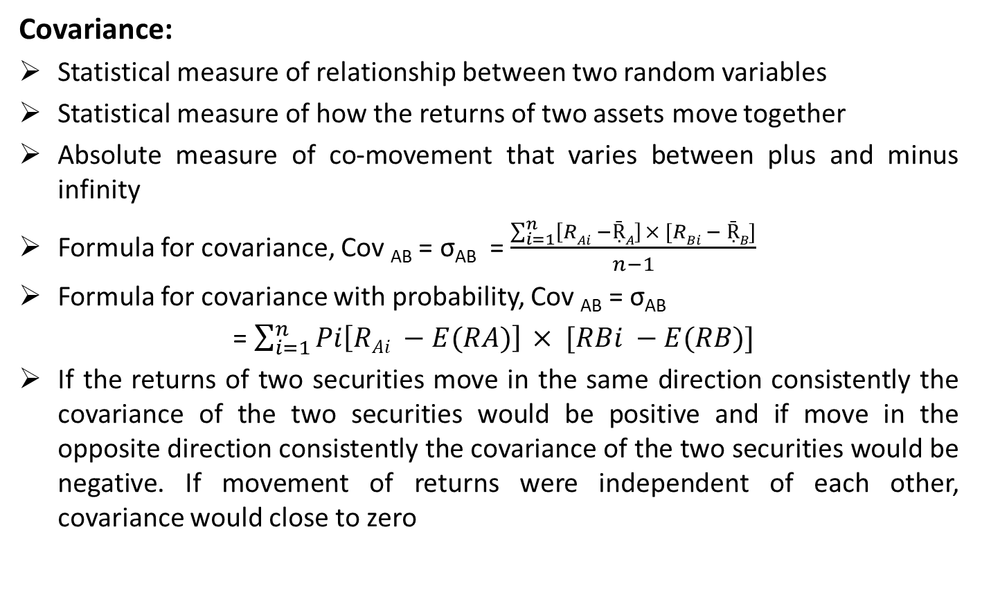
Covariance and Correlation
Covariance:
Statistical measure of relationship between two random variables
Statistical measure of how the returns of two assets move together
Absolute measure of co-movement that varies between plus and minus infinity
Formula for covariance, Cov _{AB} = σ_{AB} = $\frac{\sum_{i=1}^{n}{\left[RAi −ṜA\right]} × [RBi − ṜB]}{n−1}$
Formula for covariance with probability, Cov _{AB} = σ_{AB}
= $\sum_{i=1}^{n}{Pi\left[RAi −E(RA)\right]} × [RBi −E(RB)]$
If the returns of two securities move in the same direction consistently the covariance of the two securities would be positive and if move in the opposite direction consistently the covariance of the two securities would be negative. If movement of returns were independent of each other, covariance would close to zero

Slide 16
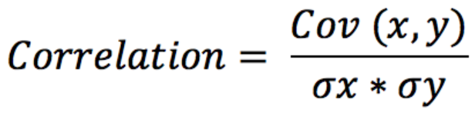
Correlation Coefficient
Standardization of covariance
Correlation is a statistical term describing the degree to which two variables move in coordination with one another
The correlation coefficients may range from -1 to +1.
-1 indicates perfect negative correlation between security returns, while a value of +1 indicates a perfect positive correlation.
A value close to zero would indicate that the returns are independent or uncorrelated.

Slide 17
Practice Question
Consider the following data for Stock A and B
Calculate the covariance and correlation between stock A and B
Consider the probability distribution and return on Stock A and B
Calculate the covariance and correlation between stock A and B
Year | 1 | 2 | 3 | 4
Return of stock A(%) | 10 | 12 | 16 | 18
Return of stock B(%) | 17 | 13 | 10 | 8
Probability | Return of stock A | Return of stock B
0.3 | 12 | 16
0.2 | 14 | 14
0.5 | 16 | 12

Slide 18
Concept of Portfolio
Combination of investments in various securities
Efficient portfolio maximizes return for a given level of risk, or minimizes risk for given level of return
By diversification or investment in more than one asset, the riskiness of one asset can be influenced by the interaction of the pattern of its returns with that of other assets it is held in combination.
Harry Markowitz developed the basic portfolio model in 1952. Assumption regarding investor behavior:
Investor are risk averse
The investor seeks to maximize the expected utility of total wealth
All investment have the same expected single period investment horizon
Investors base their investment decisions on the expected return and standard deviation of return from a possible investment
Perfect capital markets

Slide 19
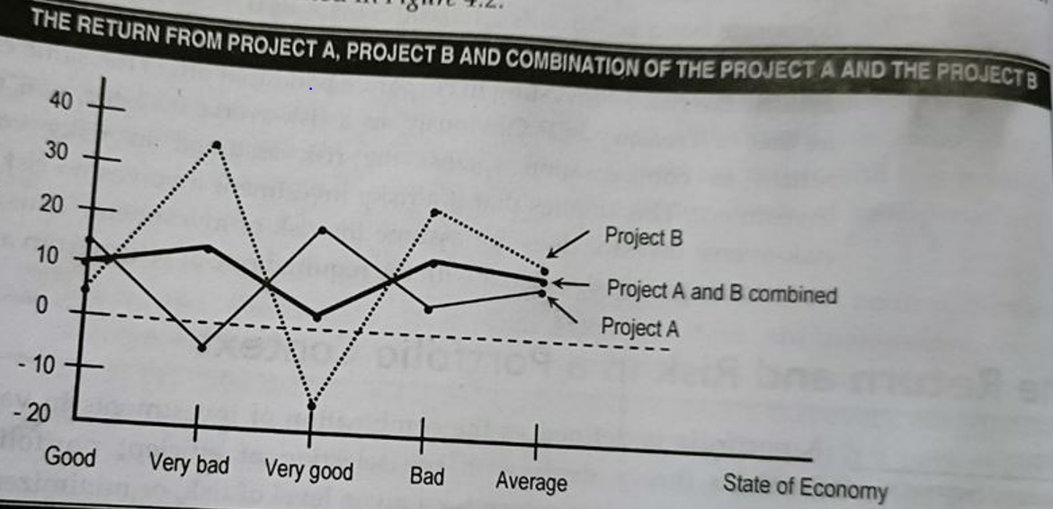
Expected rate of return on a Portfolio
Formation of portfolio stabilizes the combined return, hence reduces the risk. The only condition required is that the returns from the assets should not be perfectly and positively correlated.

Slide 20
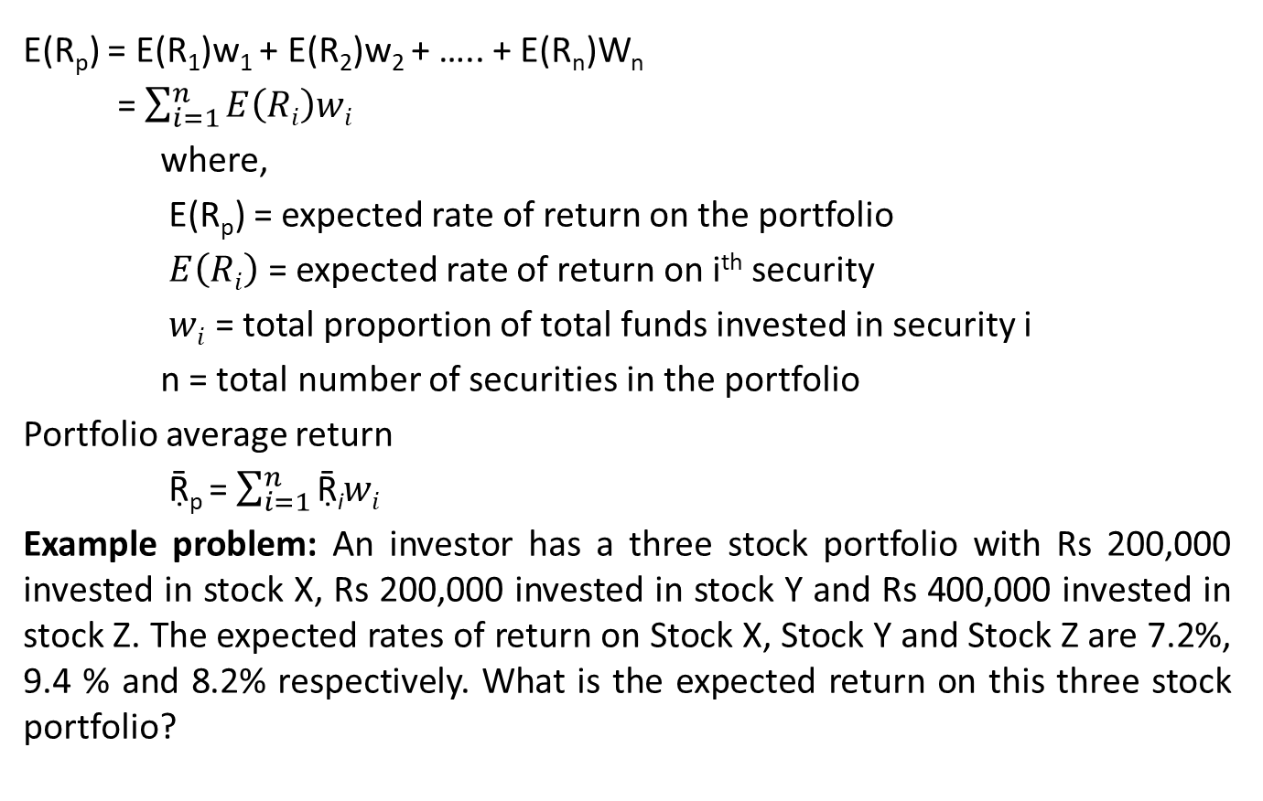
Expected rate of return on a Portfolio
E(R_{p}) = E(R₁)w₁ + E(R₂)w₂ + ….. + E(R_{n})W_{n}
= $\sum_{i=1}^{n}{E\left(Ri\right)wi}$
where,
E(R_{p}) = expected rate of return on the portfolio
$E\left(Ri\right)$ = expected rate of return on i^{th} security
$wi$ = total proportion of total funds invested in security i
n = total number of securities in the portfolio
Portfolio average return
Ṝ_{p} = $\sum_{i=1}^{n}{\text{Ṝ}\text{i}wi}$
Example problem: An investor has a three stock portfolio with Rs 200,000 invested in stock X, Rs 200,000 invested in stock Y and Rs 400,000 invested in stock Z. The expected rates of return on Stock X, Stock Y and Stock Z are 7.2%, 9.4 % and 8.2% respectively. What is the expected return on this three stock portfolio?

Slide 21
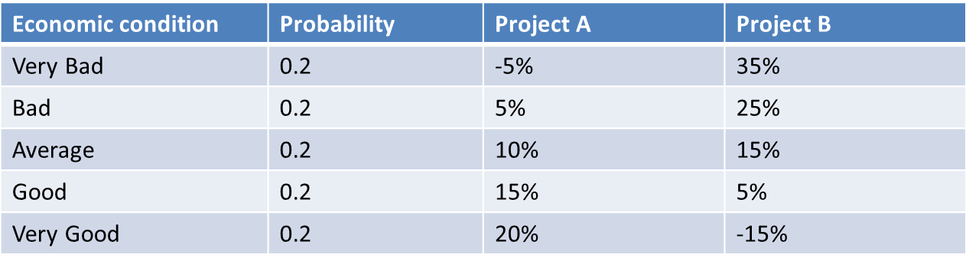
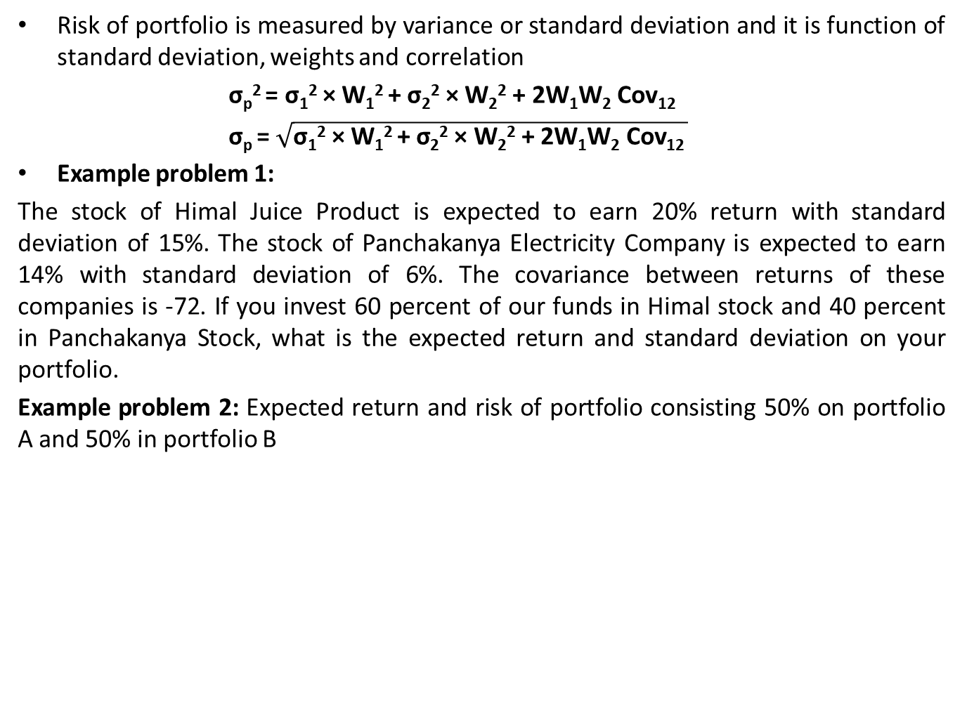
Risk on a portfolio
Risk of portfolio is measured by variance or standard deviation and it is function of standard deviation, weights and correlation
σ_{p}² = σ₁² × W₁² + σ₂² × W₂² + 2W₁W₂ Cov₁₂
σ_{p} = $\sqrt{\text{σ}\text{1}\text{2}\text{ × }\text{W}\text{1}\text{2 }\text{+ }\text{σ}\text{2}\text{2}\text{ × }\text{W}\text{2}\text{2}\text{ + 2}\text{W}\text{1}\text{W}\text{2} \text{Cov}\text{12 }}$
Example problem 1:
The stock of Himal Juice Product is expected to earn 20% return with standard deviation of 15%. The stock of Panchakanya Electricity Company is expected to earn 14% with standard deviation of 6%. The covariance between returns of these companies is -72. If you invest 60 percent of our funds in Himal stock and 40 percent in Panchakanya Stock, what is the expected return and standard deviation on your portfolio.
Example problem 2: Expected return and risk of portfolio consisting 50% on portfolio A and 50% in portfolio B

Slide 22
Correlation and Risk Reduction
Case I : Perfect Positive Correlation (ρ = +1)
risk of portfolio = weighed average of risk of individual securities
no risk reduction is achieved
Case II : Zero Correlation (ρ = 0)
less than 1; diversification can reduce the risk of portfolio
less positively correlated the returns from two securities, the greater the portfolio effects of risk reduction
Case III : Perfect Negative Correlation (ρ = -1)
there will always be some proportion of the securities that will result in the complete elimination of portfolio risk

Slide 23
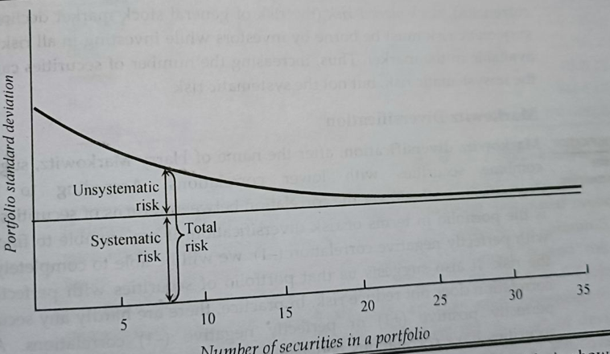
Diversification and Portfolio Risk
Portfolio diversification works because prices of different stocks do not move exactly together.
Diversification works best when returns are negatively correlated but in practice stocks that are negatively correlated are as rare.
Total risk declines as more stocks are added in the portfolio, because unsystematic risk can be reduced. However the extent of the risk reduction depends upon the degree of correlation among the stock.

Slide 24
Diversification and Portfolio Risk
Types of Diversification
Simple Diversification
mixing randomly selected securities i.e. not putting all the eggs in one basket or spreading risk.
Adding securities in the portfolio reduces the risk, but risk reduction diminishes once we add up to some level of stocks in portfolio
Total Risk = Systematic Risk + Unsystematic Risk
= Unavoidable/ Non-Diversifiable + Diversifiable Risk
Unsystematic risk is also known as unique risk because the level of this type of risk is unique to different companies.
Decreases with increase in the number of securities
Example Risk of fire on petrol pump than in soft drink stall. Risk of fire can be eliminated by investing on soft drink stall
Systematic Risk
unavoidable or cannot be diversified away
example: Risk of inflation for above 2 firms, Interest rate risk, reinvestment risk, foreign exchange risk, market risk

Slide 25
Diversification and Portfolio Risk
2. Markowitz Diversification
Combining of assets which are less than perfectly correlated in order to reduce portfolio risk.
Lower the correlation between returns of securities, the better is the portfolio in terms of risk diversification.
Investing on portfolio of securities with lower correlation better diversifies risk than investing in a portfolio of randomly selected securities.

Slide 26
Portfolio Risk: The role of correlation

Slide 27
Capital Assets Pricing Model (CAPM)
What is capital assets? – Income generating assets
Pricing Method? – relationship between price of assets and its determinants
Extension of Markowitz portfolio
Model does not directly specify the prices of capital assets, it first determines the required rate of return of the assets and then uses this rate to estimate the price of assets.
According to CAPM, required rate of return is equals to risk free rate of return plus a risk premium.
Risk premium is product of market risk premium and beta. Systematic risk is measured by beta
Risk premium is reward for bearing systematic risk
Greater the systematic risk of an assets greater will be required return of that assets
If required rate of return is greater than expected return, the asset is said to be overvalued and vice versa.
Required rate of return using CAPM is also the discount rate , which indicate the riskiness of project. Higher the required rate, more the risk and less NPV of the project and vice versa.

Slide 28
Basic Assumption of CAPM
Investors are risk averse.
Investors have no constraints on borrowing and lending
Investors have homogeneous expectations
All assets are perfectly divisible and perfectly liquid
No transaction costs
No taxes
All investors are price takers
Quantities of all assets are given and fixed
THE MODEL
R_{i} = R_{f} + (R_{m}- R_{f}) β_{i} where;
R_{i} = required rate of return on stock i
R_{f} = risk free rate of interest on risk free securities
R_{m} = return on the market or an average stock
Β_{i} = Beta coefficient on stock i
R_{m}- R_{f} = security’s risk premium
Market risk premium = market return – risk free rate

Slide 29
Example problem of CAPM
Assume that risk free rate is 5 percent and market return is 12 percent. You are considering an investment, Stock Q that has beta coefficient of 1.2. what is the market risk premium? What is the risk premium on Stock Q? What is the required rate of return on Stock Q as per CAPM? How do you compare the risk premium of Stock Q against that of market? Why required rate of return on Stock Q is higher than the market?

Slide 30
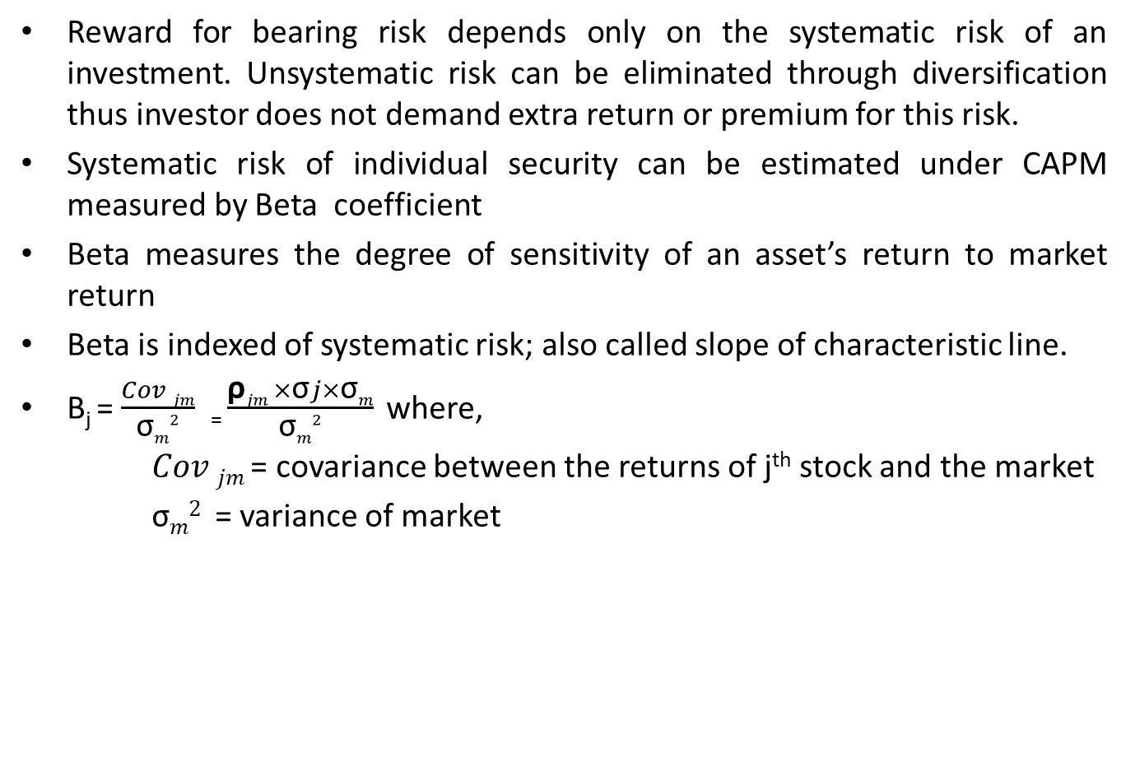
Estimation of Beta
Reward for bearing risk depends only on the systematic risk of an investment. Unsystematic risk can be eliminated through diversification thus investor does not demand extra return or premium for this risk.
Systematic risk of individual security can be estimated under CAPM measured by Beta coefficient
Beta measures the degree of sensitivity of an asset’s return to market return
Beta is indexed of systematic risk; also called slope of characteristic line.
Β_{j} = $\frac{Cov jm}{\text{σ}m2}$ ₌ $\frac{\text{ρ}jm ×\text{σ}j×\text{σ}m}{\text{σ}m2}$ where,
$Cov jm$= covariance between the returns of j^{th} stock and the market
$\text{σ}m2$ = variance of market

Slide 31
Some important points about beta
Measure the non diversifiable or market risk of a security
Beta for market is 1
Stocks may have positive or negative betas; nearly all are positive
Stocks with beta greater than 1 are more responsive to changes in market return and therefore more risky than market. Stocks with betas less than 1 are less risky than the market
Because of its greater risk, higher a stock’s beta, greater should be its level of expected return and vice versa

Slide 32
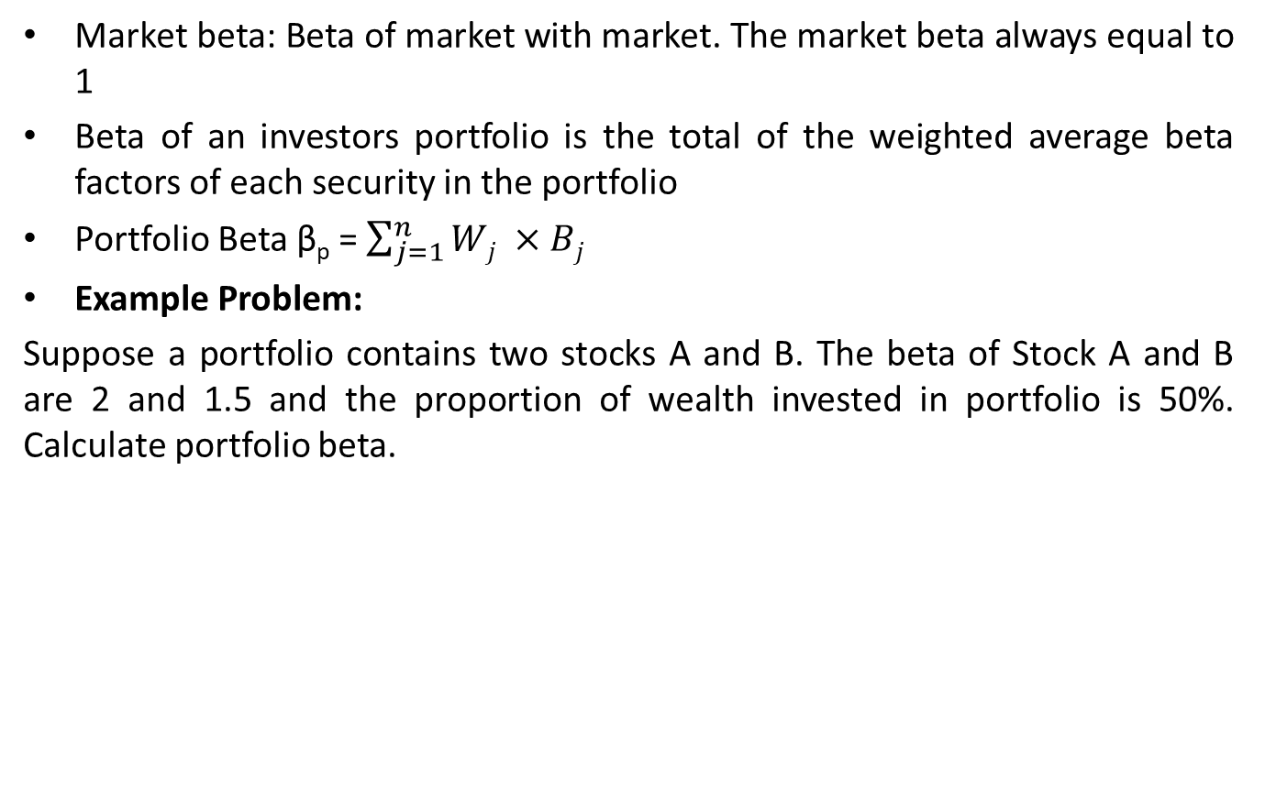
The market portfolio and Portfolio Risk
Market beta: Beta of market with market. The market beta always equal to 1
Beta of an investors portfolio is the total of the weighted average beta factors of each security in the portfolio
Portfolio Beta β_{p} = $\sum_{j=1}^{n}{Wj ×Bj}$
Example Problem:
Suppose a portfolio contains two stocks A and B. The beta of Stock A and B are 2 and 1.5 and the proportion of wealth invested in portfolio is 50%. Calculate portfolio beta.

Slide 33
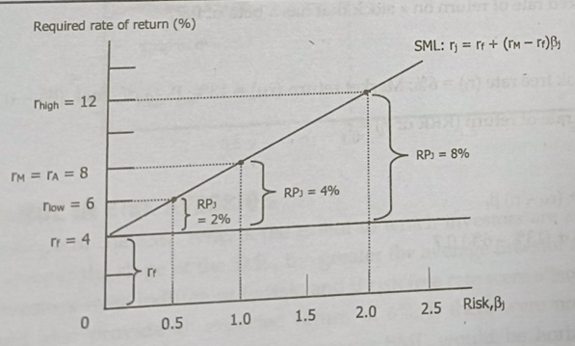
Security Market Line (SML)
For a well diversified portfolio, the unsystematic risk is reduced to become zero and the only relevant risk is systematic risk measured by beta
SML express the basic theme of CAPM i.e. expected return of security increases linearly with risk, as measured by beta
SML is graphical representation of CAPM

Slide 34
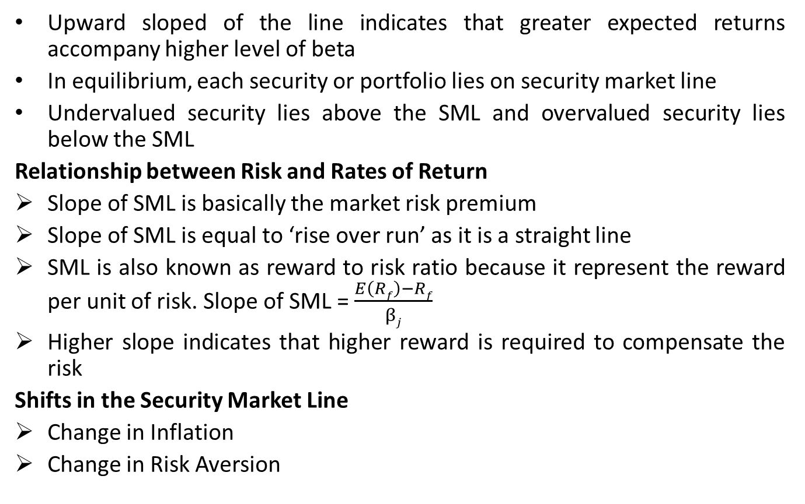
Security Market Line
Upward sloped of the line indicates that greater expected returns accompany higher level of beta
In equilibrium, each security or portfolio lies on security market line
Undervalued security lies above the SML and overvalued security lies below the SML
Relationship between Risk and Rates of Return
Slope of SML is basically the market risk premium
Slope of SML is equal to ‘rise over run’ as it is a straight line
SML is also known as reward to risk ratio because it represent the reward per unit of risk. Slope of SML = $\frac{E\left(Rf\right)−Rf}{βj}$
Higher slope indicates that higher reward is required to compensate the risk
Shifts in the Security Market Line
Change in Inflation
Change in Risk Aversion

Slide 35
Problem
Stock A and B have the following historical return
Calculate the average rate of return for each during the period 2013 through 2017.
Assume that someone held an portfolio consisting of 50% of stock A and 50% of stock B. What have been the realized rate of return on the portfolio in each year from 2013 through 2017? What would have been the average return on the portfolio during this period?
Calculate the standard deviation of return for each stock and for the portfolio.
Calculate the coefficient of variation for each stock and for the portfolio.
If you are a risk averse investor, would you prefer to hold Stock A, Stock B or the portfolio?
Year | Return (R_{A}) | Return (R_{B})
2013 | 8% | 16%
2014 | 10% | 14%
2015 | 12% | 12%
2016 | 14% | 10%
2017 | 16% | 8%

Slide 36
Problem
The following data permits to the next four questions. Stocks A and B have returns and probability distributions as given below.
Calculate the expected returns for Stocks A and B.
What are the standard deviations of expected returns for stock A and B?
Calculate the covariance between Stocks A and B.
Calculate the correlation coefficient between Stock A and B.
Suppose you want to hold a portfolio composed of 50% of Stock A and 50% of Stock B. What will be the expected return (mean) and risk (standard deviation) of your portfolio?
Probability | Stock A | Stock B
0.25 | 6% | 8%
0.30 | 10% | 2%
0.25 | 4% | 6%
0.20 | 8% | 8%

Slide 37
Problem
Consider the following information.
Required:
Mean and standard deviation of market return and stock’s return
Covariance of stock and market return
Beta coefficient of Stock A and its interpretation
Required rate of return of Stock A if risk free rate is 5 percent
Is stock A overpriced or underpriced or correctly priced? Would you buy this stock ? Why ?
Probability | Return of Stock-J | Market Return
0.3 | 15% | 20%
0.4 | 9% | 5%
0.3 | 18% | 12%

Slide 38
Problem
You are given the following information:
Risk free rate of return = 5%
Market interest rate = 10%
Based on the above information:
Find required rate of return on each stock
Draw the SML
Stock | Beta
Satyam | 2
Wipro | 0.75
Infosys | 1.75

Slide 39
Problem
Stock X has a 10 percent expected return, a beta coefficient of 0.9 and 35% standard deviation of expected returns. Stock Y has a 12.5% expected return, beta coefficient of 1.2 and a 25% standard deviation. The risk-free rate is 6 percent and the market risk premium is 5%.
Calculate each stock’s coefficient of variation
Which stock is riskier for a diversified investors?
Calculate each stock’s required rate of return
On the basis of the two stocks’ expected and required returns, when stock would be most attractive to a diversified investors?
Calculate the required return of a portfolio that has Rs 7,500 invested in Stock X and Rs 2,500 invested in Stock Y.
If the market risk premium increased to 6 percent, which of the two stocks would have the largest increase in their required return?

Slide 40
Problem
The market and Stock J have following probability distribution of returns:
Calculate the expected rate of return of the market and stock J
Calculate the standard deviation for the market and Stock J
Calculate beta coefficient of Stock J. What does it indicate ?
Probability | Return on Market | Return on Stock J
0.3 | 10% | 20%
0.5 | 9% | 5%
0.2 | 15% | 10%

Slide 41
Problem
Suppose you held a diversified portfolio consisting of a Rs 7,500 investments in each of 20 different common stocks. The portfolio beta is equal to 1.12. Now suppose you have decided to sell one of the stocks in your portfolio with a beta of 1.0 for Rs 7,500 and use the proceeds to buy another stock with a beta of 1.75. What would your portfolio’s new beta be?
Suppose you are the money manager of a Rs 4 million investment funds. The fund consists of four stocks with following investment and betas:
If the market required rate of return is 14 percent and the risk free rate is 6 percent, what is the fund’s required rate of return?
Stock | Investment | Beta
A | Rs 400,000 | 1.50
B | Rs 600,000 | (0.50)
C | Rs 1,000,000 | 1.25
D | Rs 2,000,000 | 0.75

Slide 42
Problem
Suppose there are three equally risky outcomes for the economy, the expected return on Auto stock and Gold stocks are as follows:
Calculate the expected return on Auto Stock and Gold Stock
Calculate standard deviation of each stock
Calculate coefficient of variation of each stock
If you formulate the portfolio of Auto and Gold stock, by investing 75% on auto and 25% on gold, what is portfolio expected return and standard deviation
Do you think that above portfolio is worthful ? Why ?
 |  | Rate of Return (%)
Scenario | Probability | Auto Stock | Gold Stock
Recession | 1/3 | -8 | +20
Normal | 1/3 | +5 | +3
Boom | 1/3 | +18 | -20

